Slide 1
CSTOOL.io
CSTOOL.io
The Cybersecurity Toolbox

Slide 2

Existing cybersecurity tools have high entry barriers:

Slide 3

You have to ask for a personal sales demonstration…

Slide 4

You have to install, roll-out, customize, arrange a 30 day PoC…

Slide 5

Or they follow a premium pricing strategy aimed at servicing few, large clients…

Slide 6
Large companies
Buying the cow
…don’t realize that solutions are there. Roll their own or stick with XLS although unhappy.
Tools are monolithic. You need it for one job but you buy the whole thing.
Small companies
IT Departments
Make or buy
…can’t afford it, invest more time using XLS, Outlook.
…need to get involved, take time to provide test environment.
Self-grown solutions end up costing much more, but off-the-shelf tool was not visible enough.
The effects

Slide 7

A tool that is good enough and works now beats the competition.

Slide 8

Introducing CSTOOL.io
A cloud-based, secure, open, scalable, self-customizable Cybersecurity Toolbox.

Slide 9
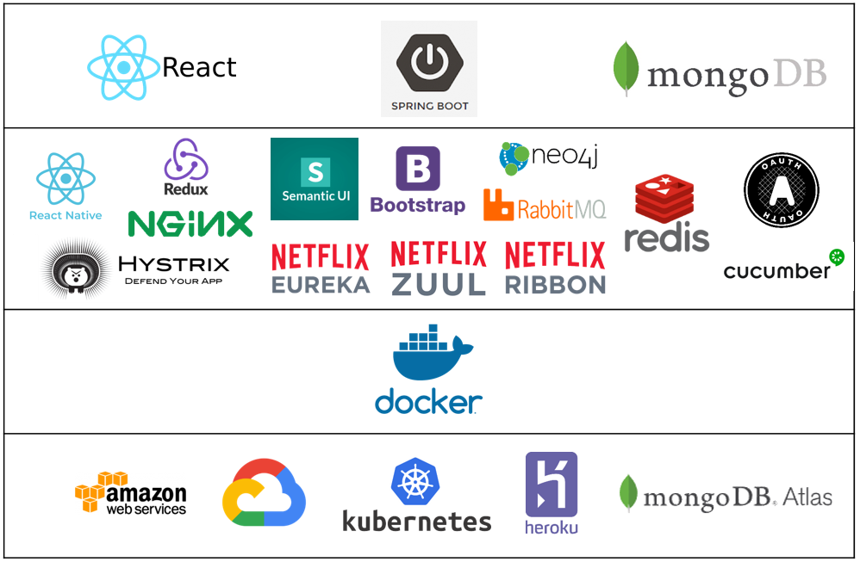
Tech Stack
Built on open source software and cloud infrastructure

Slide 10
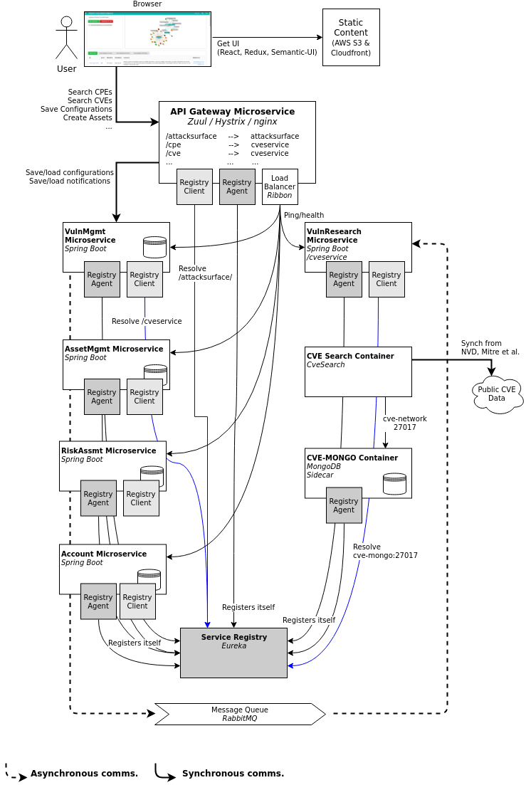


















Microservice Architecture
Stateless, scalable design

